Slide 1

Enhancing Medication Adherence through Mobile Application
by
M. Swathi Reddy
Roll No. 204G1A05A9
Leena Sri
Roll No. 214G5A0507
C. Soumya
Roll No. 204G1A05A0
M. Parimala
Roll No. 204G1A0570
Under the guidance of
Mr. C. Sudheer Kumar M.Tech.(Ph.D)
Assistant Professor
Department of Computer Science and Engineering
Srinivasa Ramanujan Institute of Technology
(Autonomous)
2023 - 2024

Slide 2
Comments
Improve your tentative app screenshots
Add future extension
How to Authenticate Doctors and Patients
Add Aadhar Field in Patient Registration form

Slide 3
Contents
Abstract
Problem statement
Objectives of Project
Literature survey
Existing Work
Proposed Work
Planning
Design
Implementation
Research Paper
References

Slide 4
Abstract
Human forgetfulness is a common occurrence, but should not be in the case of medicines where adherence is necessary for better treatment. Research indicates that lack of following the prescribed schedules results in substantial negative health implications and sometimes premature deaths caused by medication non-adherence.
To address all the issues, there is a need of developing a mobile application specially designed for managing the medications. The main objective of this application is to provide automatic medicine reminders by enabling doctors to prescribe medications directly through the application and this data is synchronized with the patient’s interface, ensuring accurate and real-time updates.
Keywords : Mobile Application, Medication Adherence, Reminder System, Automatic alarm.

Slide 5
Problem Statement
Despite the availability of numerous reminder applications, patients occasionally encounter confusion regarding the administration of medication and certain instances of incorrectly set reminders may arise.
To address these challenges, this application offers a dedicated interface enabling doctors to establish comprehensive reminders including dosage instructions.
The medication adherence can be improved which helps people lead a happy and healthy life.

Slide 6
Objectives of Project
Research Objective – 1: To help patients take their medications on time with the help of medicine reminders.
Research Objective – 2: To provide an interface where doctors can directly prescribe the medication which automatically gets updated in the patient Mobile Application

Slide 7
Literature Survey
S.A.Patil [1] focuses on setting the alarm and get notification from it. The patient must fill out a form first with their name, mobile number, email address, gender, and password. Patient can log in using provided email address or mobile number in an application. However, the patient must be aware that the proper mobile number, email address, and password must be entered. Describes about the various advantages and disadvantages of the application.
Samir V.Zanjal [2] discuss about Home based health care arrangement which include communications, imaging, sensing and human computer interaction technologies. The monitoring system uses the self-powering wireless environment with the help of renewable energy.

Slide 8
Literature Survey
KeeHyun Park [3] In this paper, Park proposed a medication reminder synchronization system that provides a patient with medications as prescribed by medical staff. In addition, medical staff can remotely send messages to the system in order to change the medication schedules or device configuration settings embedded in the medication reminder.
Lindsey Dayer [4] Medication adherence usually refers to whether patients take their drugs as prescribed and whether they continue to take a prescribed medication. Medication non-adherence is an increasing concern for clinicians, healthcare systems, and other stakeholders because to mounting evidence that it is widespread and associated with negative outcomes and greater healthcare expenditures.

Slide 9
Existing System
In the world of healthcare, there are lots of applications that remind people to take their medicine. But, since patients have to set these reminders themselves, they might make mistakes. These mistakes could mean they take the wrong medicine or forget to take it altogether. It's really important to take medicine at the right time and in the right amount for it to work well. So, even if doctors have made a plan for treatment, it will only be successful if patients stick to taking their medicine exactly when they're supposed to.
Drawbacks :
Patients may set reminders wrongly.
There is uncertainty regarding whether the medication has been taken punctually or not.

Slide 10
Proposed System
To resolve the issues in the existing system our mobile application introduces a seamless integration between healthcare and technology by offering an interface that enables doctors to directly issue prescriptions linked to patient IDs. This integration ensures synchronization with the patient application, triggering automated reminders for timely medication intake.
By aligning reminders with prescribed medications, the system eliminates ambiguities, providing patients with precise dosage instructions and schedules. The application incorporates features allowing patients to mark medicines as taken, cancel doses, or provide feedback, enhancing medication tracking and adherence.

Slide 11
Proposed System
The proposed system contains the following facilities over the present system
Automated reminders based on direct prescription integration enhance adherence by reducing the chances of missed doses.
The application establishes a direct and efficient communication channel between doctors and patients, promoting clearer instructions and feedback.
Features like marking medicines as taken and cancelling doses provide real-time insights into patients' medication intake, aiding healthcare providers in monitoring progress.
Automation of reminders and direct prescription issuance saves time for both healthcare providers and patients, streamlining the prescription and adherence process.

Slide 12
Planning
Functional Requirements
Including both doctors and patients, should have secure and reliable authentication mechanisms to access the application.
A feature allowing admins to register doctors in the system, associating each doctors email and password.
A system that automatically generates and sends reminders to patients based on the prescribed medication schedules.
Non Functional Requirements
Mantainability
Fault Tolerance
Accessibility

Slide 13
Planning
System Requirements:
Hardware Requirements:
RAM : 8GB
Hard Disk : 1TB
Processor: i5 and above
Software Requirements:
IDE : Visual Studio Code
Plugin : Dart, Flutter
SDK : Flutter
Database : Firebase

Slide 14
Planning
Methodology
This project uses Agile methodology. In that we use scrum agile methodology.
Scrum is characterized by cycles or stages of development, known as sprints.
It has four stages: Planning, Implementation, Testing and review.
Advantages
This Methodology has ability to change and adapt with and satisfy the changing needs in short term.
Requires less documentation.

Slide 15
Planning
User Registration and Authentication
This module manages user registration for both doctors and patients.
Patients provide their personal information including phone number, name, age, and Aadhar number during registration.
Upon registration, patients are assigned a unique Patient ID.
Authentication mechanisms ensure secure access to the system for registered users.

Slide 16
Planning
Doctor Interface
This module provides a user interface for doctors to manage medication reminders and prescriptions.
Doctors can log in using their credentials and access features to prescribe medications and set reminders for patients.
It includes options to search for patients by their Patient IDs and add family members for monitoring.

Slide 17
Planning
Medication Prescribing and Reminder Setting
This module enables doctors to prescribe medications and set reminder schedules.
Doctors can link prescriptions to patient IDs, specifying medication details and dosage instructions.
Reminder settings are directly integrated with prescription issuance, ensuring that patients receive timely notifications.

Slide 18
Planning
Patient Mobile Application
This module provides a mobile application interface for patients to receive medication reminders and manage prescriptions.
Patients log in using their credentials or Patient IDs assigned during registration.
The application syncs with the doctor's interface to display prescribed medications and reminder schedules.

Slide 19
Planning
Work Schedule
S.No | Development Stage | Duration
1. | Domain and Title | 1 week
2. | Literature Survey | 1 week
3. | Planning | 1 week
4. | Design | 2 weeks
5. | Requirements Gathering | 1 week
6. | Testing | 2 weeks
7. | Implementation | 4 weeks

Slide 20
Design
Hospital
Patient
Patient Registration & Doctor Login
Doctor prescribe medicines
Alarm Handling

Slide 21
Design
Medicine Schedule
Doctor/Patient Login into the System
Medicine Reminder
Patient Alarm
Patient Pill Prescription
Patient Medication History
Medication Adherence
Fig 2 : Data Flow Diagram for Medicine Reminder

Slide 22
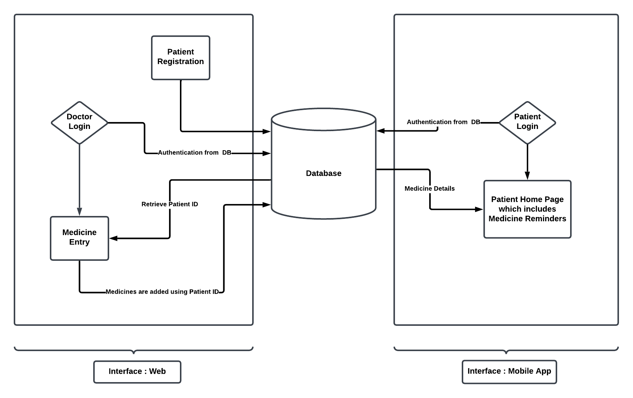
Design - Architecture

Slide 23
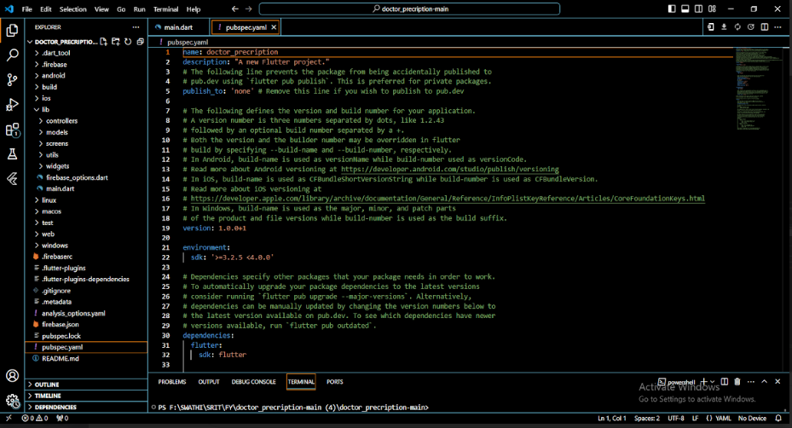
Implementation
pubspec.yaml

Slide 24
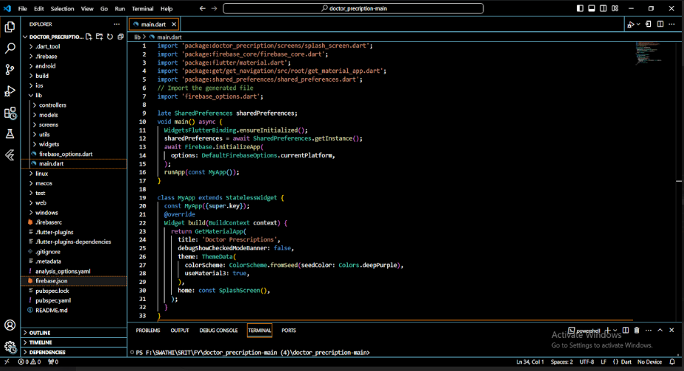
Implementation
main.dart

Slide 25
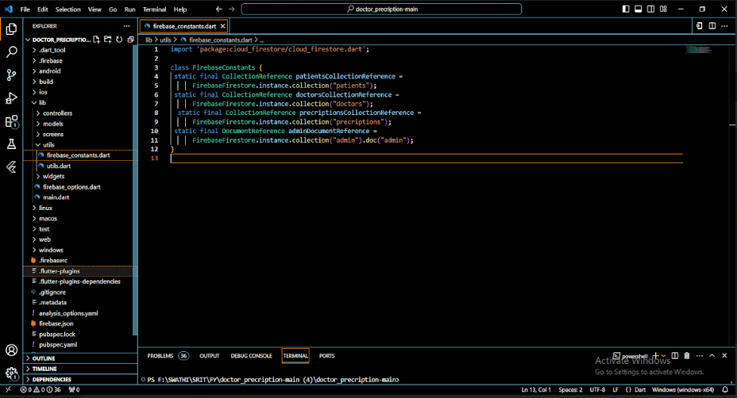
Implementation
firebase_constants.dart

Slide 26
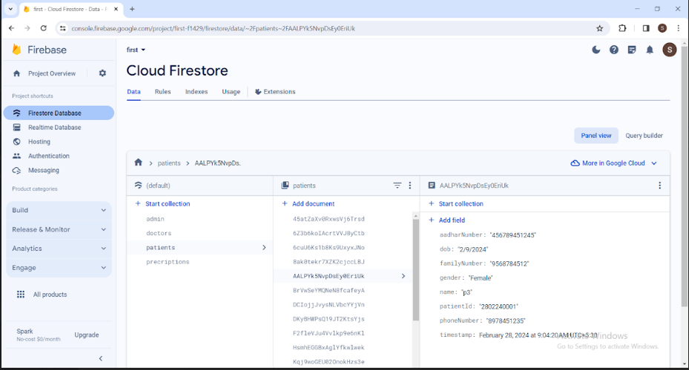
Implementation
Cloud Firestore

Slide 27
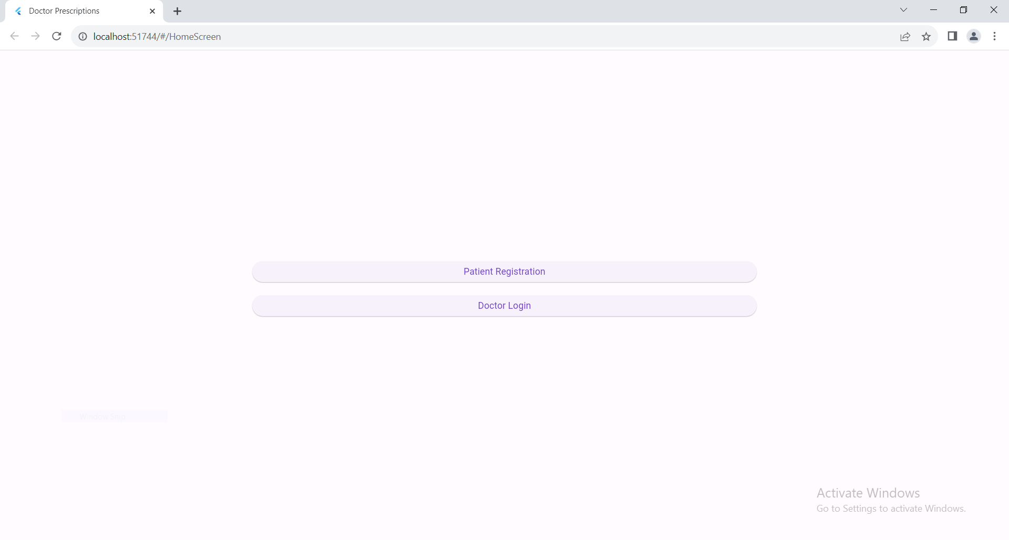
Implementation

Slide 28
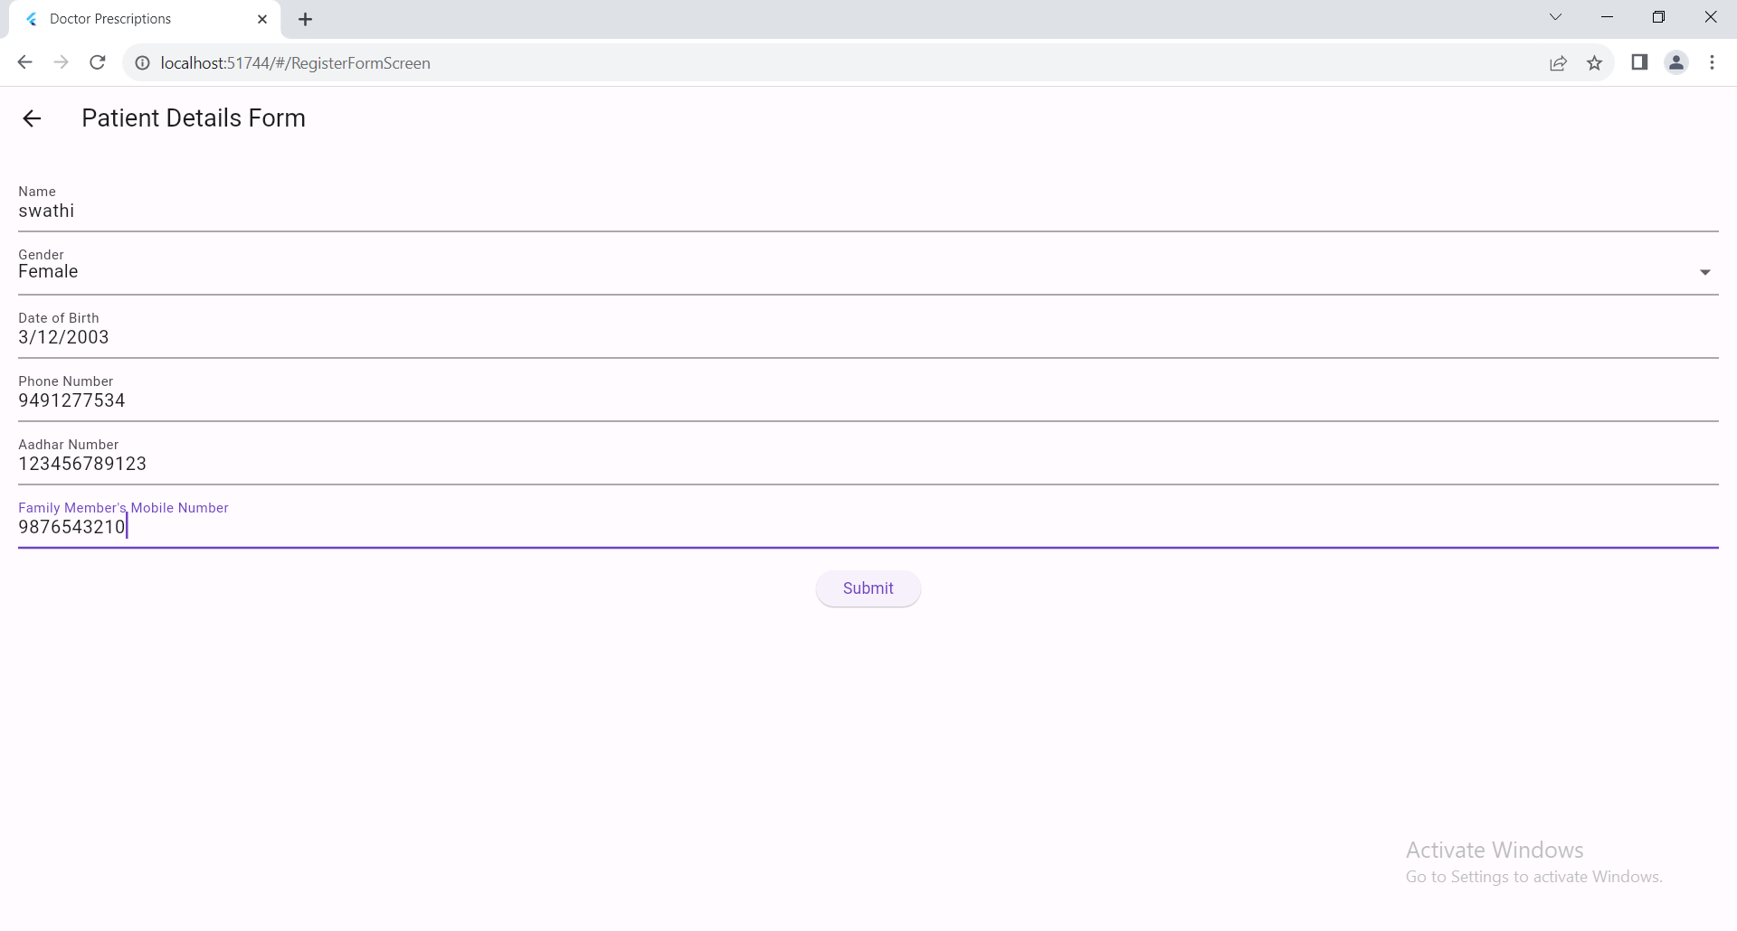
Implementation

Slide 29
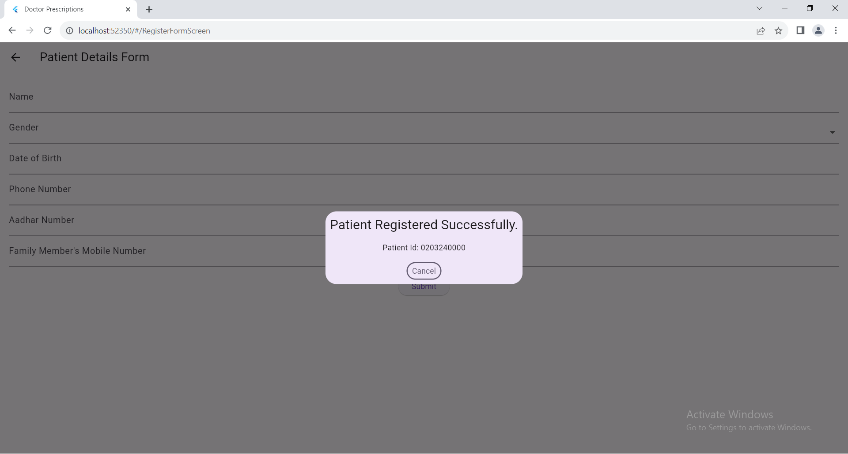
Implementation

Slide 30
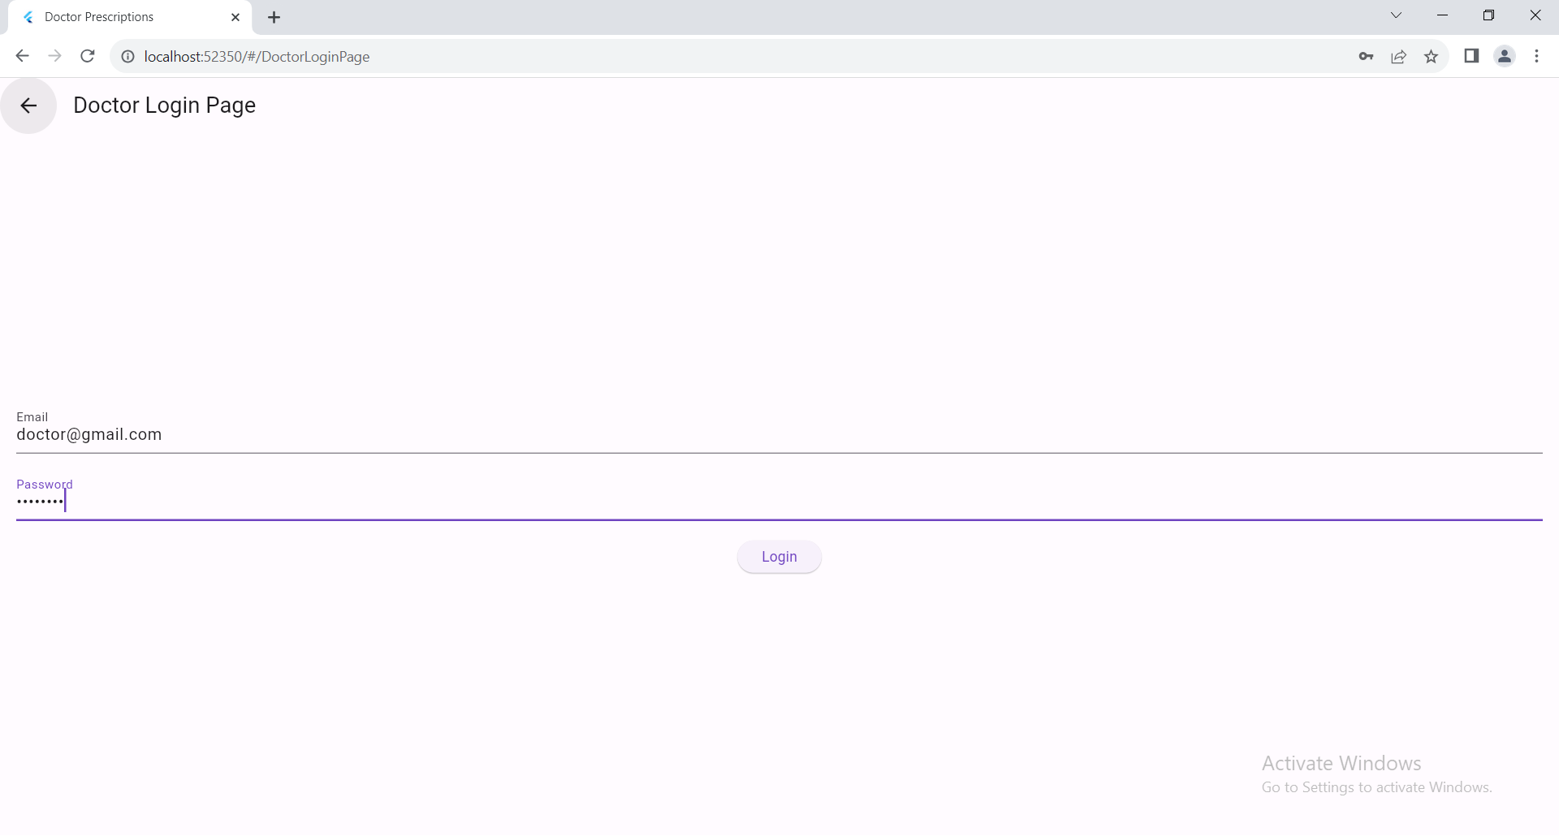
Implementation

Slide 31
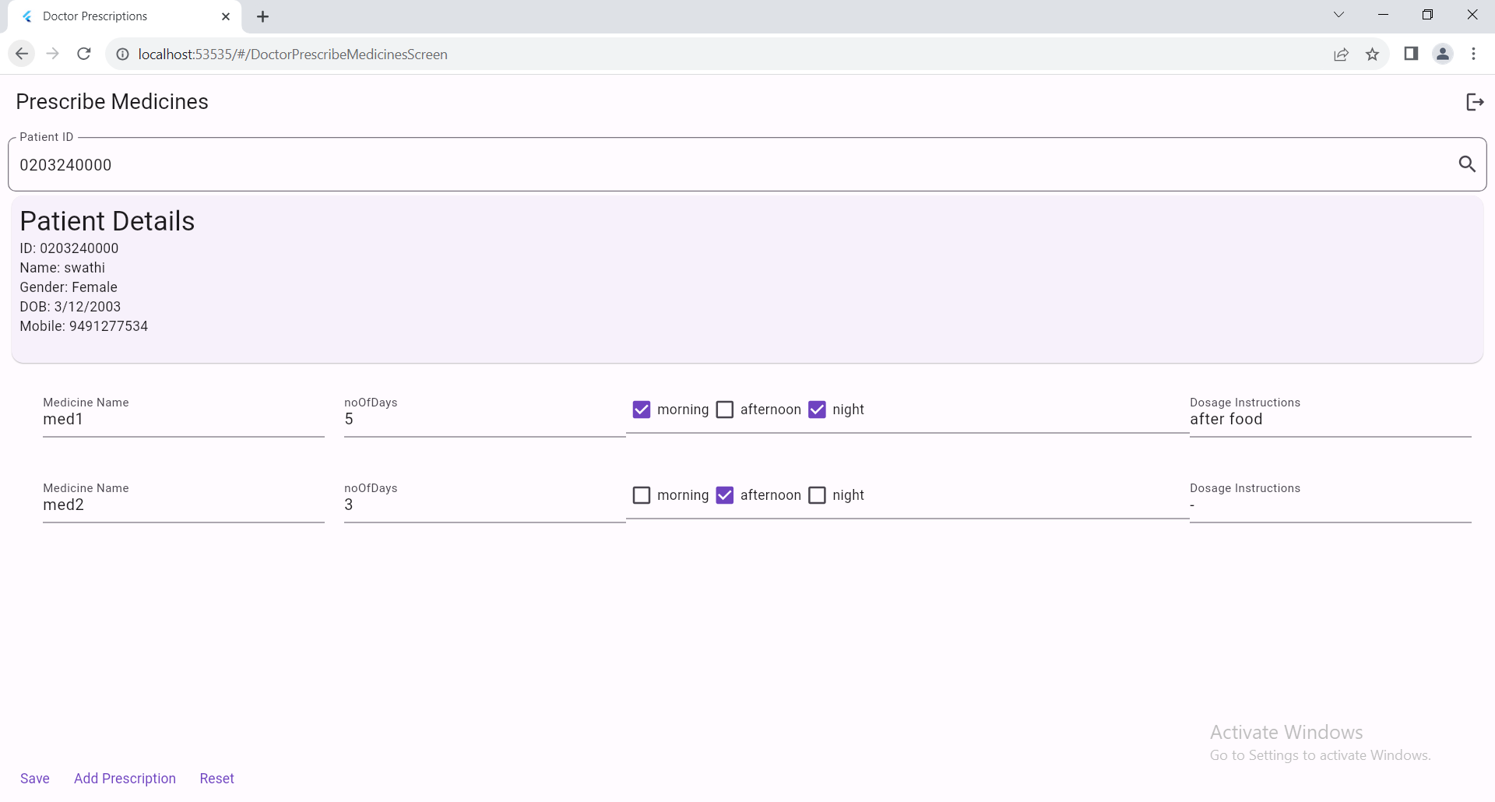
Implementation

Slide 32
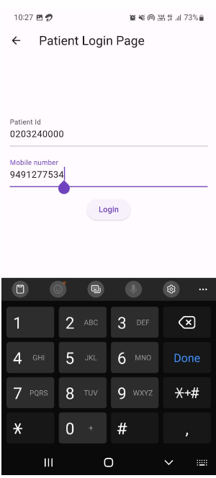
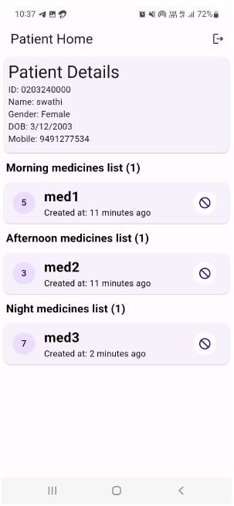
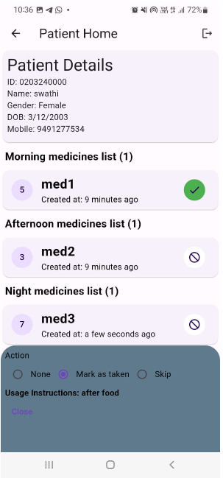
Implementation

Slide 33
Research Paper
Research Paper

Slide 34
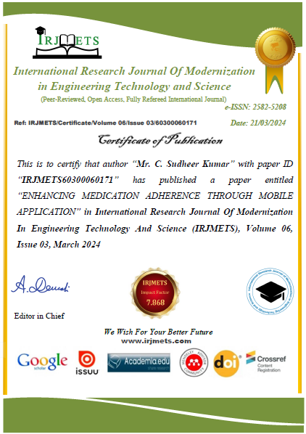
Certifications

Slide 35
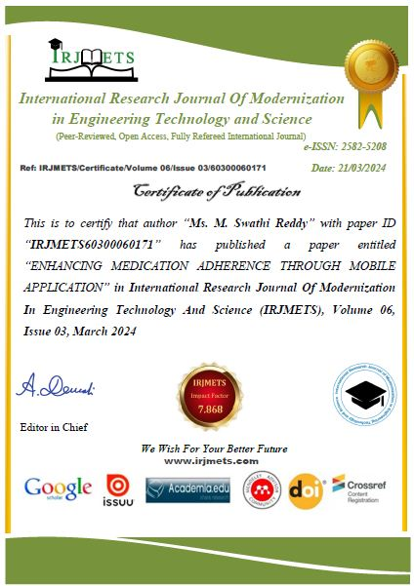
Certifications

Slide 36
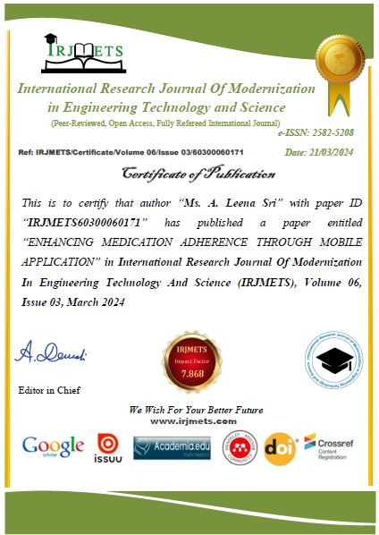
Certifications

Slide 37

Certifications

Slide 38
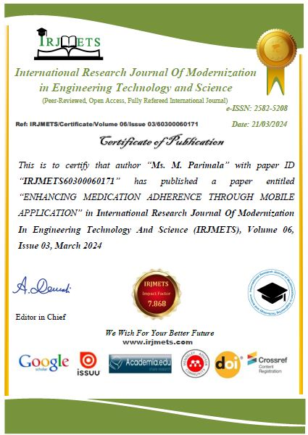
Certifications

Slide 39
References
[1] S.A.Patil, Monika Bhanuse, Snehal Mali and Vishaka Swami , “Review on Mobile application for Medicine Reminder”, International Research Journal of Modernization in Engineering Technology and Science, Volume:03/Issue:02/February-2021.
[2] Samir V.Zanjal and Girish. R. Talmale, “Medicine Reminder and Monitoring System”, International Conference on Information Security and Privacy, December 2020.
[3] KeeHyun Park and Seung Hyeon Lim, “Construction of a Medication Reminder Synchronization”, International Journal of Bio-Science and Bio-Technology Vol. 4, No. 4, December, 2012.
[4] Lindsey Dayer, “Smartphone medication adherence apps”, National Library, DOI: 10.1331/JAPhA.2013.12202.

Slide 40
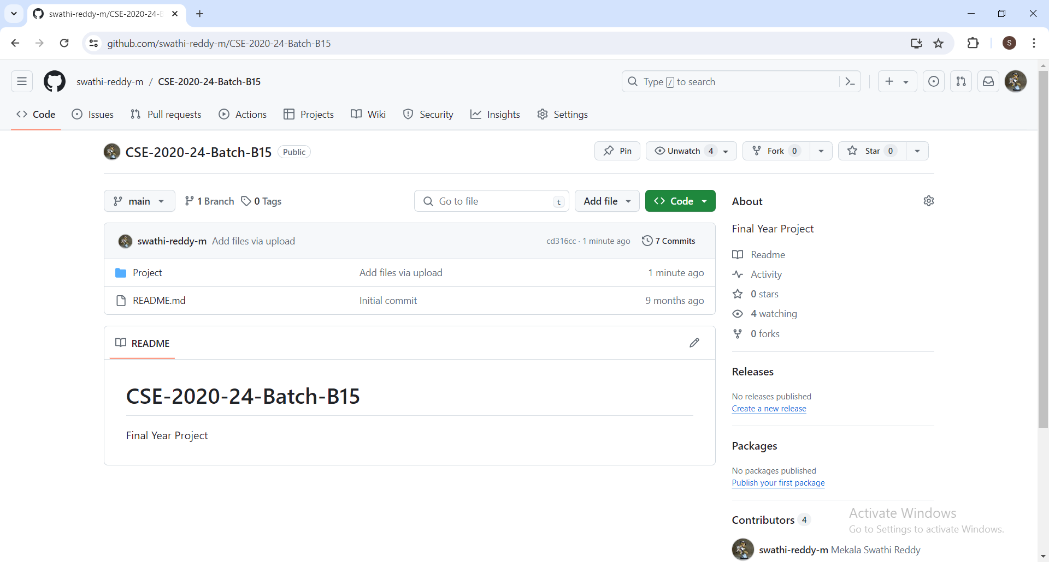
GitHub Dashboard
GitHub Link : https://github.com/swathi-reddy-m/CSE-2020-24-Batch-B15

Slide 41
Thank you

